Slide 1
Virtual Personal Assistant
using RPA, AI and Python
EN18CS301291 Vivek Patidar
EN19CS3T1002 Pranav Gautam
Under the guidance of: Mr. Prasanna Kapse

Slide 2
TABLE OF CONTENTS
Introduction
Problem Statement
System Analysis and Design
Research Paper
Modeling
Functionality
Conclusion

Slide 3


Slide 4
As our world becomes more digital, virtual assistants powered by advanced AI are bridging the gap between the digital and human worlds. Consumers and corporations may get help with a variety of chores. But what is a virtual assistant, and what can it help you with? A virtual assistant is a digital assistant that uses voice recognition features and language processing algorithms to recognize the voice commands of the user and perform relevant tasks as requested by the user.
This system is designed to be used efficiently on desktops and mobiles. Personal assistant software improves user productivity by managing routine tasks of the user and by providing information from online sources to the user. It is effortless to use and within seconds, it executes the command or query.This project was started on the premise that there is a sufficient amount of openly available data and information on the web that can be utilized to build a virtual assistant that has access to making intelligent decisions for routine user activities. In summary, we've developed an AI-powered virtual assistant that can execute all of these tasks and more without causing any disruptions.

Slide 5

The Problem

Slide 6
Usually, a user needs to manually manage multiple sets of applications to complete one task. For example, a user trying to make a travel plan needs to check for airport codes for nearby airports and then check travel sites for tickets between combinations of airports to reach the destination. There is a need for a system that can manage tasks effortlessly. We already have multiple virtual assistants but we hardly use them or there are some disadvantages associated with the ones we rarely use. For example, Apple’s Siri doesn’t maintain a knowledge database of its own and its understanding comes from the information captured in domain models and data models. Hence, the user doesn’t get a personalized experience. Similarly, Google’s assistant is known to consume a large amount of battery and it requires users to give access to a lot of data which raises privacy issues.
Moreover, people have so many issues with these assistants. These systems can understand English phrases but they fail to recognize our accent. Also, they are easier to use on mobile devices than desktop systems. And one of the major drawbacks of these assistants is that they get overwhelmed during a complex query and can’t extract information from conversations. There is a need for a virtual assistant that can understand English in any accent and work on a desktop system. When a virtual assistant is not able to answer questions accurately, it’s because it lacks the proper context or doesn’t understand the intent of the question.

Slide 7
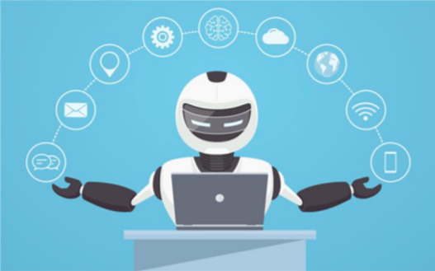
SYSTEM ANALYSIS AND DESIGN
REQUIREMENTS
SYSTEM STRUCTURE
WORKING PRINCIPLES

Slide 8
REQUIREMENTS
FUNCTIONAL REQUIREMENTS
Personal assistant software is required to act as an interface into the digital world by understanding user requests or commands and then translating into actions or recommendations based on the assistant's understanding of the world. Focus is on capturing the user input through voice, recognizing the input and then executing the tasks if the assistant understands the task. Software takes this input in natural language, and so makes it easier for the user to input what he or she desires to be done. Voice recognition software enables hands free use of the applications, letting users to query or command the agent through voice interface. This helps users to have access to the assistant while performing other tasks and thus enhances the value of the system itself. VPA also has ubiquitous connectivity through Wi-Fi or LAN connection, enabling distributed applications that can leverage other APIs exposed on the web without a need to store them locally.

Slide 9
2. NON-FUNCTIONAL REQUIREMENTS
The system ensures safety, security, and usability, which are observable during operation (at run time). The system is adaptable to different situations. The system has a good and compact UI with responsive interface. The project is light on resources.
This project is technically feasible with no external hardware requirements. Also it is simple in operation and does not cost training or repairs. Overall feasibility study of the project reveals that the goals of the proposed system are achievable.

Slide 10
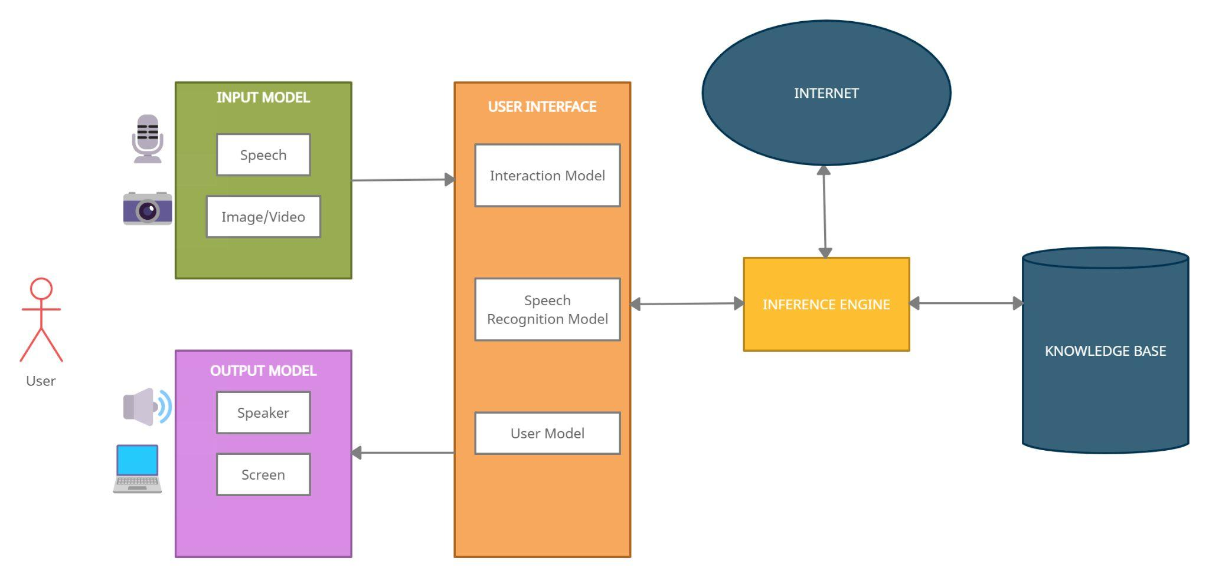
SYSTEM STRUCTURE

Slide 11
1. KNOWLEDGE BASE
There are actually 2 knowledge bases from which the assistant gets its information. First is the internet which can be accessed only if there’s an active internet connection. It is used to provide answers to any query that is related to the internet.
Second is the local knowledge base. We don’t need an internet connection to access it. This database store things like user’s name, his/her preferences, system settings etc.
2. SPEECH RECOGNITION MODEL
The speech recognition model will work in real-time with the microphone and the input model to recognize the utterances that a user speaks into a microphone and then convert it to text; then it understands the problem and returns the result in both text and voice forms.

Slide 12
3. INTERACTION MODEL
This is the main model that will be used to provide interaction between user and the system by receiving the data from the input model and analyzing it, then returning results.
4. INFERENCE ENGINE
The inference engine works together with the Interaction Model in the chain of conditions and derivations and finally deduces the outcome by analyzing all the facts and rules, then sorting them before concluding to a solution.
5. USER MODEL
This model has all information about all the users that will use the system. It can include personal information such as users' names and ages, their interests, their skills and knowledge, their goals and plans, their preferences and their dislikes or data about their behavior and their interactions with the system. The system will hold only the data that the user wants it to. All information will be collected by asking the user some questions then storing all answers in the Knowledge Base.

Slide 13
6. INPUT MODEL
This model will organize the work of all input devices that the system uses to collect the different data from microphones of all the devices used, camera (if any query is image/video). Also, this model includes intelligence algorithms to organize the input information before sending the data to the Interaction Model.
7. OUTPUT MODEL
This model will receive the final decision from the Interaction Model, then it will show the result through text, voice, image/video (if applicable).

Slide 14
WORKING PRINCIPLES
1. SPEECH RECOGNITION
The programme converts speech input to text using python’s speech recognition module. With voice input, users can get texts from specialized corpora arranged on the information center's computer network server, which are briefly kept in the system before being forwarded for speech recognition. The equivalent text is then received and fed to the central processor.
2. PYTHON BACKEND
The Python backend receives the voice recognition module's output and determines if the instruction or voice output is an API Request and Context Extraction.
3. RPA
Robotic Process Automation (RPA) is a software technology that allows digital operations like data entering, word processing, and chatting to be automated and hence is very helpful for us as it lets us get rid of a lot of manual tasks.

Slide 15
4. COGNITIVE AUTOMATION
It is the application of machine learning that is used to automate processes that would otherwise require physical labor. This with RPA lets us tackle any complex or complicated query. When used with data science techniques it also helps us overcome the accent problem.
5. NLP
Natural language processing is an area of AI that aims to enable computers to interpret text and spoken words in the same manner that humans can and hence it makes our assistant feel natural and not a robot, like google’s assistant.
6. API CALLS
A software interface that allows two programmes to interact with one another is known as an API (application programming interface). To put it another way, an API is a messenger that transmits your request to the provider and then returns the response. This lets us scrap the web and use the internet according to the user’s queries or commands.

Slide 16
7. CONTENT EXTRACTION
Context extraction (CE) is the process of obtaining structured data from machine-readable materials that are unstructured or semi-structured. In most situations, this activity entails employing natural language processing to process human language documents (NLP). Test results for context extraction may be seen in recent operations in multimedia document processing, such as automated annotation and content extraction from images, audio and videos.
8. NEURAL NETWORKING
The assistant may learn about users and become more customized as a result of neural networking with the database maintained, eventually carrying out activities without the user having to ask.
9. MACHINE LEARNING
ML aids the assistant in doing many jobs and answering tough queries. VPA also uses machine learning to acquire insight into a person's preferences based on prior decisions and data.

Slide 17
10. TEXT-TO-SPEECH MODULE
The capacity of computers to read text aloud is referred to as text-to-speech (TTS). Written text is converted to a phonemic representation, which is subsequently converted to waveforms that may be generated as sound by a TTS Engine. Third-party publishers offer TTS engines in a variety of languages, dialects, and specialist vocabularies.
11. CHROME DRIVER
It is an open source tool for automated testing across many browsers. It provides capabilities for navigating to web pages, user input, JavaScript execution, and more.
12. SELENIUM WEB AUTOMATION
Selenium is an open source umbrella project for a range of tools and libraries aimed at supporting browser automation. It provides a playback tool for authoring functional tests without the need to learn a test scripting language.

Slide 18
13. SQLITE
SQLite is a database engine written in the C language. It is not a standalone app; rather, it is a library that software developers embed in their apps. As such, it belongs to the family of embedded databases. We have used SQLite to maintain the database of every user and the knowledge base.

Slide 19

ABSTRACT
INTRODUCTION
RELATED WORK
PROPOSED METHOD
REFERENCES

Slide 20
ABSTRACT
Technological progress is accelerating day by day. Human-computer interaction is becoming more convenient as a result of speech-enabled virtual assistants that provide a wide range of services and can connect to smart environments, reducing physical interaction with the system. However, people face several issues while interacting with these assistants due to their numerous weaknesses, like a lack of understanding complex queries and not maintaining the personalized data of users, etc. As a consequence, the interaction is impaired, and in some cases, ineffective. For this reason, we have developed a virtual assistant using RPA (Robotic Process Automation), AI (Artificial Intelligence), Python, and ML (Machine Learning) that can eliminate these problems and do so with increased accuracy. Hence, this paper proposes to create a virtual assistant that can make human-computer interaction as smooth and efficient as possible.

Slide 21
INTRODUCTION
People no longer rely on other humans for assistance or services. Because of the digitalization of the world, humans no longer need to rely on others for assistance; instead, they may rely on considerably more systematic and dependable equipment to meet their daily demands. VPA (Virtual Personal Assistant) has practically become a requirement. However, although it is reasonably efficient, it is not particularly useful and is not used by the user owing to its high mistake rate. Hence, the aim of our project is to create a VPA that eliminates all these problems.
Virtual assistants may be beneficial in a variety of sectors, including IT helpdesk, home automation, HR-related chores, voice-based search, and so on. Voice-based search is the future of the next generation, with users relying heavily on voice assistants for all of their requirements.

Slide 22
A virtual assistant is capable of doing a variety of tasks. Users can use it to get basic answers and recommendations based on their profile, previous activity, and additional behavior. Moreover, our new version of the digital assistant can allow users to turn on the lights, make grocery lists, and turn off the heating when they are away from home.
Organizations can use this digital assistant in customer care to manage incoming contacts. It can also support a wide range of IT operations. Routine procedures like system upgrades, information management, and even transaction orders may be automated.
Moreover, it can be used in the automobile industry, making safety an increasingly important issue. Using voice commands instead of touch-tones is not only a convenience, it is being perceived by consumers as a safety necessity as the user doesn’t have to interact physically with the system and can focus on the driving while using just voice commands to interact.
In summary, we've developed an AI-powered virtual assistant that can execute all of these tasks and more without causing any disruptions.

Slide 23
RELATED WORK
SURVEY 1
Author: A. Sudhakar Reddy M., Vyshnavi, C. Raju Kumar, and Saumya.
Paper Title: Virtual Assistance using Artificial Intelligence.
Publication: A. Sudhakar Reddy M., Vyshnavi, C. Raju Kumar, and Saumya, "VIRTUAL ASSISTANT USING ARTIFICIAL INTELLIGENCE ", International Journal of Emerging Technologies and Innovative Research (www.jetir.org), ISSN:2349-5162, Vol.7, Issue 3, page no. 1116-1119, March-2020.
Findings: (a) Minimizes the interruption of the user.
(b) Improves the utilization of time.
(c) Provides a single point of communication.
Conclusion: The use of AI and NLP is recognizable but couldn’t really solve the problems of different accents and complex queries

Slide 24
SURVEY 2
Author: George Terzopoulos, Maya Satratzemi.
Paper Title: Voice Assistants and Smart Speakers in Everyday Life and in Education.
Publication: George Terzopoulos, Maya Satratzemi, “Voice Assistants and Smart Speakers in Everyday Life and in Education”, Informatics in Education, v19 n3 p473-490 2020.
Findings: (a) Shows the role of VPA in everyday life.
(b) Talks how VPA can be super helpful for students.
Conclusion: It showed how we can connect these VPAs with external devices using IoT such as speakers.

Slide 25
SURVEY 3
Author: Regina Gubareva, Rui Pedro Lopes.
Paper Title: Virtual Assistants for Learning: A Systematic Literature Review.
Publication: Regina Gubareva, Rui Pedro Lopes, “Virtual Assistants for Learning: A Systematic Literature Review”, CSEDU20-RP-93, May-2020.
Findings: (a) Showed the different uses of virtual personal assistants.
(b) Talked about the different techniques for developing these assistants.
Conclusion: It showed the versatility of the assistant, as how can these assistants do different tasks in different fields. This shows that VPAs have unlimited scope.

Slide 26
SURVEY 4
Author: Emad S. Othman.
Paper Title: Voice Controlled Personal Assistant Using Raspberry Pi.
Publication: Emad S. Othman. “Voice Controlled Personal Assistant Using Raspberry Pi”. International Journal of Scientific and Engineering Research Volume 8, Issue 11, November-2017.
Findings: (a) Showed the importance of voice command system.
(b) Showed how using open source modules helps our system.
Conclusion: The Raspberry Pi has numerous disadvantages, such as it doesn’t work on desktop systems.

Slide 27
SURVEY 5
Author: V. Radha, C. Vimala.
Paper Title: A review on speech recognition challenges and approaches.
Publication: V. Radha and C. Vimala, “A review on speech recognition challenges and approaches” doaj.org, vol. 2, no. 1, pp. 1–7, 2012.
Findings: (a) The fundamentals of speech recognition are discussed.
(b) Recent progress of speech recognition is investigated.
(c) Feature extraction technique and speech recognition process is compared.
Conclusion: Shows us the importance of speech recognition. Most general mode of communication is speech and a speech based assistant should solve most of our problems.

Slide 28
SURVEY 6
Author: Bassam A., Raja N.
Paper Title: Arabic speech recognition using hidden markov model toolkit.
Publication: Bassam A. & Raja N. (2010) “Arabic speech recognition using Hidden Markov Model Toolkit (HTK)”. 2. 557 - 562. 10.1109/ITSIM.2010.5561391.
Findings: (a) Talked about the communication between humans and machines and how it is converted from analog signals to digital waves.
(b) Talked about the importance of HMM and MFCC in speech recognition.
Conclusion: The accuracy of speech recognition was above 95%, also it was concluded that speech recognition is not limited to a single language.

Slide 29
SURVEY 7
Author: Elshafei M.
Paper Title: Virtual Personal Assistant for Mobile users.
Publication: Elshafei, M., Virtual personal assistant (VPA) for mobile users. Mitel Networks (2000–2002).
Findings: The service here is based only on the convergence of internet and speech recognition
Conclusion: It tells us how virtual assistants have improved over time and how every piece of research has been helpful towards the intelligent and smart assistants we have now.

Slide 30
SURVEY 8
Author: B. S. Atal, L. R. Rabiner.
Paper Title: A pattern recognition approach to voiced unvoiced-silence classification with applications to speech recognition.
Publication: B. S. Atal and L. R. Rabiner, “A pattern recognition approach to voiced unvoiced-silence classification with applications to speech recognition” Acoustics, Speech and Signal Processing, IEEE Transactions on, vol. 24, no. 3, pp. 201–212, 1976.
Findings: The method has been found to provide reliable classification with speech segments as short as 10 ms and has been used for both speech analysis-synthesis and recognition applications.
Conclusion: The authors explained regarding speech analysis, and the result is regularly completed in combination with pitch analysis. The research described a pattern recognition technique for determining whether a given slice of a speech signal should be categorized as voiced speech, unvoiced speech, or silence, depending on dimensions finished on signal.

Slide 31
SURVEY 9
VPA: Google Assistant.
Released Date: Google Assistant was released on May 18, 2016.
Pros: Google Assistant can sync your preferred searching terms across devices such as Computers, Smartphones, Google Home, and other platforms. So, it helps to find your query quickly and learn them by AI and makes it easier to perform your task quicker across the platforms. You can even sync your search history as well. Google Assistant can learn your preferences and it will help to save your time when switching across the devices.
Cons: We can hear some cracks and unpleasant sound breaks while performing the action. We feel like we’re interacting with robots, not the assistant. There have been many unethical and privacy concerns over critics. Since we are giving our information to the assistant it might later turn out to be a sci-fi horror movie. Privacy advocates even raised concerns about the millions of vocal samples being recorded and used as feedback for virtual assistants.

Slide 32
SURVEY 10
VPA: Apple’s Siri.
Released Date: Siri was released on October 4, 2011.
Pros: Siri is a master of record-keeping, it helps people from maintaining copious amounts of documentation, and streamlines the process of note-taking and documenting. The problem solving abilities of Siri are also top notch, even when it couldn’t give the exact answers yet it still helps. Out of the box, Siri’s language is English. But, if you don’t speak English fluently or simply want to practice a language you are currently learning, Siri can be a great help, as Siri comes with non-English language options.
Cons: Siri has a lack of function. Either she’s having trouble connecting, or she’s turning your dictation into gibberish, or she’s bringing the web results you didn’t ask for. Apple has even been sued for overstating its claims of Siri’s abilities. Also, to date, Apple’s website continues to refer to Siri as “beta only”.Siri’s data collecting is vague and not advanced enough. The biggest disadvantage of Siri is that it does not maintain a knowledge database of its own and its understanding comes from the information captured in domain models and data models.

Slide 33
PROPOSED METHOD
Virtual assistants should be able to model complex task dependencies and use these models to recommend optimized plans for the user. It needs to be tested for finding optimum paths when a task has multiple sub-tasks and each sub-task can have its own sub-tasks. In such a case, there can be multiple solutions to paths, and it should be able to consider user preferences, other active tasks, and priorities in order to recommend a particular plan.
Main objective of building a personal assistant is using semantic data sources available on the web, user generated content and providing knowledge from knowledge databases. One of the main purposes of an intelligent virtual assistant is to answer questions that users may have. This may be done in a business environment, for example, on the business website, with a chat interface. On the mobile platform, the virtual personal assistant is available as a call-button operated service where a voice asks the user for a command or query and responds accordingly.

Slide 34
One of the main advantages of voice search is its rapidity. In fact, voice is reputed to be almost four times faster than a written search. We can write about 40 words per minute, whereas we are capable of speaking around 150 during the same period of time. In this respect, the ability of personal assistants to accurately recognize spoken words is a prerequisite for them to be adopted by consumers.
Virtual assistants are the most advanced kind of robotic automation. Our virtual assistant gathers information from a variety of sources and contextualizes it, learning from each encounter. The virtual assistant can process everything that is said or written and utilize it to generate an accurate answer using advanced language processing. Using AI and machine learning, our virtual assistant can handle various tasks and complicated queries. It uses neural networking to acquire insight into one's preferences based on prior selections and data. In this way, when the user interacts with the virtual assistant, it becomes a unique experience that meets their needs.

Slide 35
This virtual assistant extracts information and complicated data from interactions using advanced artificial intelligence (AI), robotic process automation (RPA), natural language processing, and machine learning. RPA is a smart software application that excels in automating repetitive and rule-based processes using highly organized data. However, RPA can also get confused during the time of a complex query. If data is more unstructured or conventional criteria aren't applicable, cognitive automation can help. The term "cognitive automation" refers to a mix of RPA and data science methodologies that is particularly effective when dealing with textual information. With a speech and text-based user interface, our virtual assistant takes this to the next level. It is capable of extracting information and complicated facts from conversations and comprehending them appropriately.
The main goal of this project is to improve the accuracy of the voice-to-text software. That is, the software will potentially be able to translate any speech with minor modulations or varied accents into text with the high degree of accuracy and precision required for VPA’s day-to-day use.

Slide 36
REFERENCES
A. Sudhakar Reddy M., Vyshnavi, C. Raju Kumar, and Saumya, "VIRTUAL ASSISTANT USING ARTIFICIAL INTELLIGENCE ", International Journal of Emerging Technologies and Innovative Research (www.jetir.org), ISSN:2349-5162, Vol.7, Issue 3, page no. 1116-1119, March-2020.
George Terzopoulos, Maya Satratzemi, “Voice Assistants and Smart Speakers in Everyday Life and in Education”, Informatics in Education, v19 n3 p473-490 2020.
Regina Gubareva, Rui Pedro Lopes, “Virtual Assistants for Learning: A Systematic Literature Review”, CSEDU20-RP-93, May-2020.
Emad S. Othman. “Voice Controlled Personal Assistant Using Raspberry Pi”. International Journal of Scientific and Engineering Research Volume 8, Issue 11, November-2017.
V. Radha and C. Vimala, “A review on speech recognition challenges and approaches” doaj.org, vol. 2, no. 1, pp. 1–7, 2012.
Bassam A. & Raja N. (2010) “Arabic speech recognition using Hidden Markov Model Toolkit (HTK)”. 2. 557 - 562. 10.1109/ITSIM.2010.5561391.
Elshafei, M., Virtual personal assistant (VPA) for mobile users. Mitel Networks (2000–2002).
B. S. Atal and L. R. Rabiner, “A pattern recognition approach to voiced unvoiced-silence classification with applications to speech recognition” Acoustics, Speech and Signal Processing, IEEE Transactions on, vol. 24, no. 3, pp. 201–212, 1976.
Jatu Naazneen, Abdul Gaffar, Abhijit Palse, “Virtual Assistant using Python”, DTSS COLLEGE OF COMMERCE, 2018-2019.

Slide 37
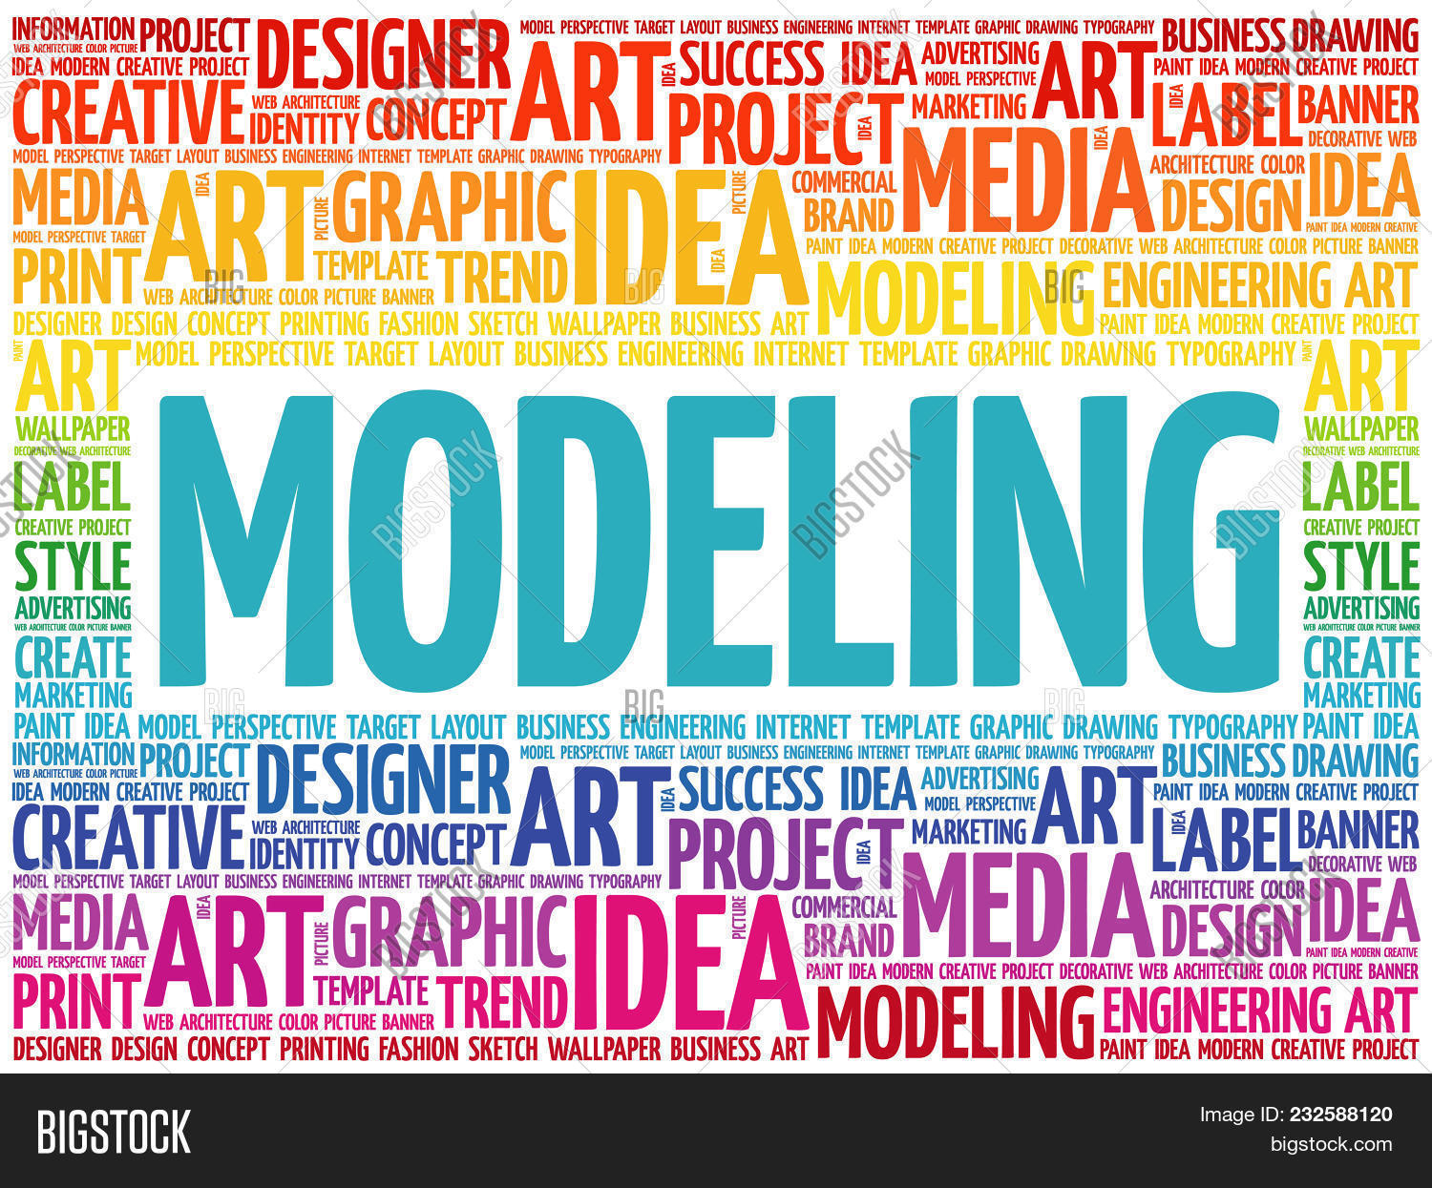

Slide 38
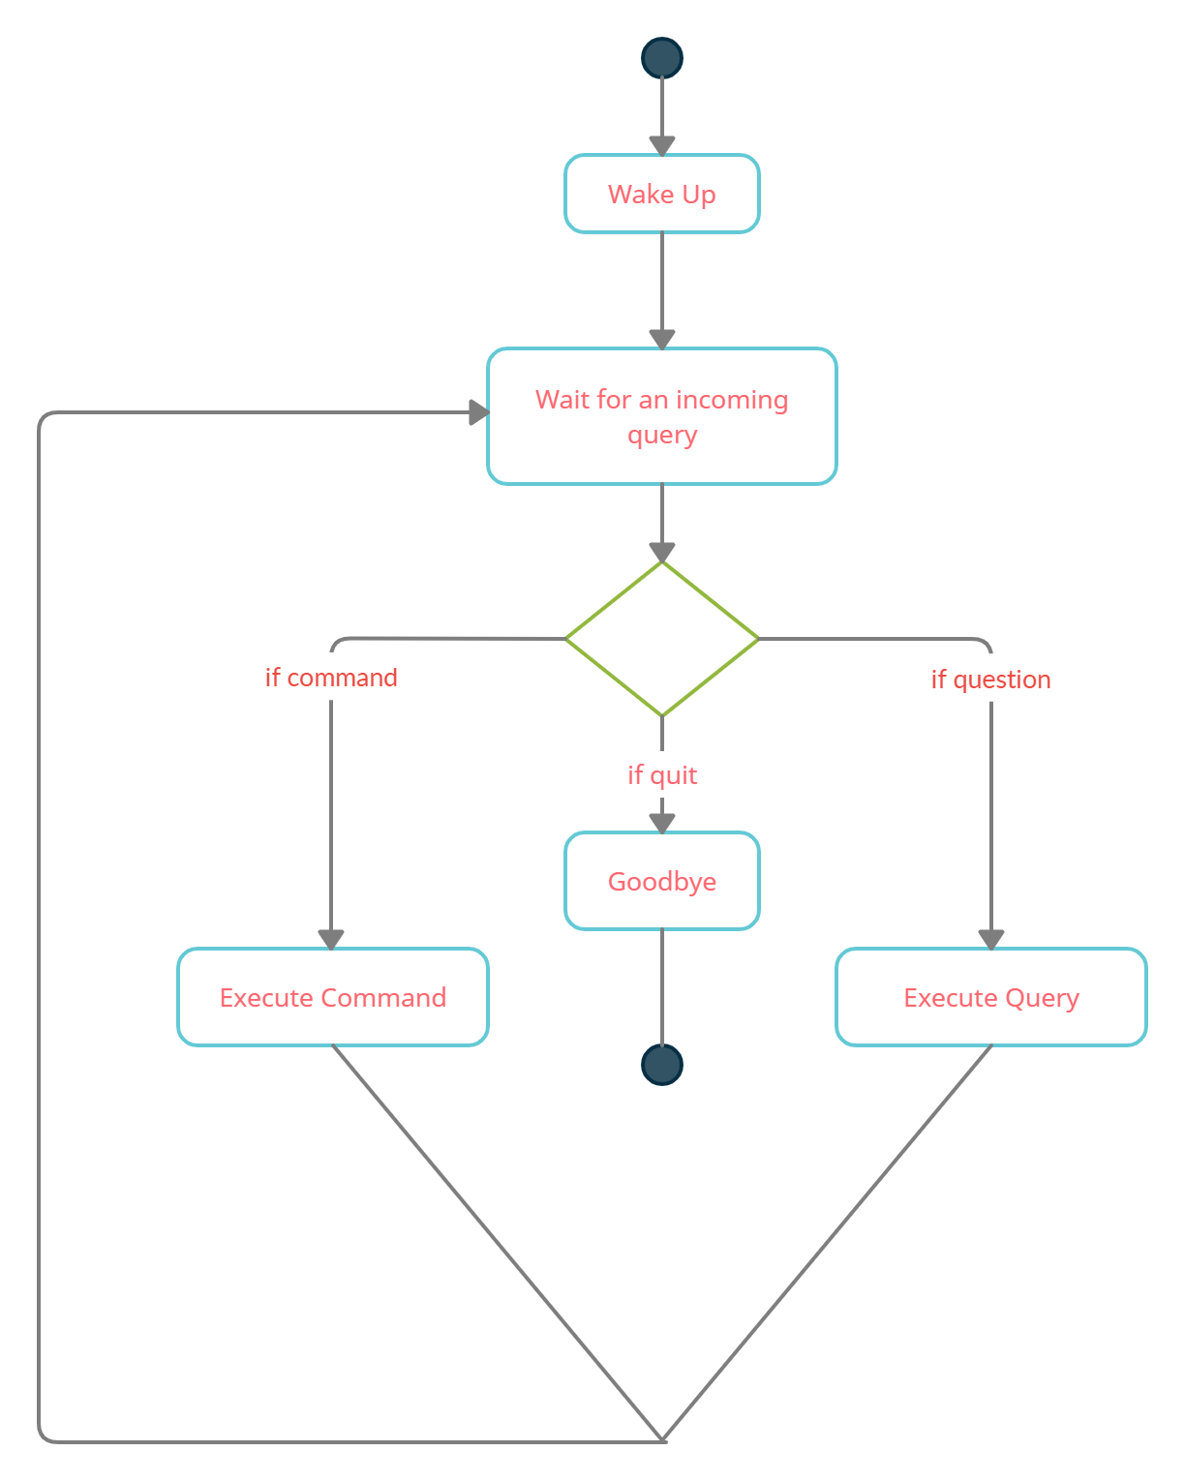
ACTIVITY DIAGRAM
Initially, the system is in idle mode. As it receives any wake up call it begins execution. The received command is identified whether it is a questionnaire or a task to be performed. Specific action is taken accordingly. After the Question is being answered or the task is being performed, the system waits for another command. This loop continues unless it receives a quit command. At that moment, it goes back to sleep.

Slide 39
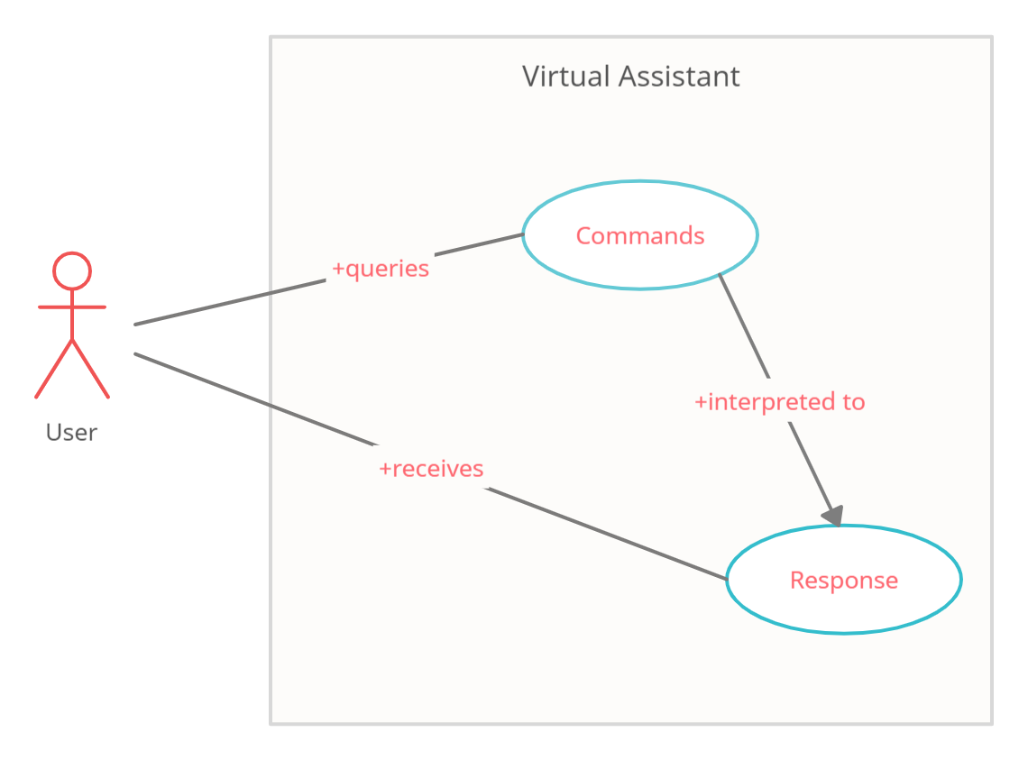
USE CASE DIAGRAM
In this project there is only one user. The user queries command to the system. System then interprets it and fetches an answer. The response is sent back to the user.

Slide 40
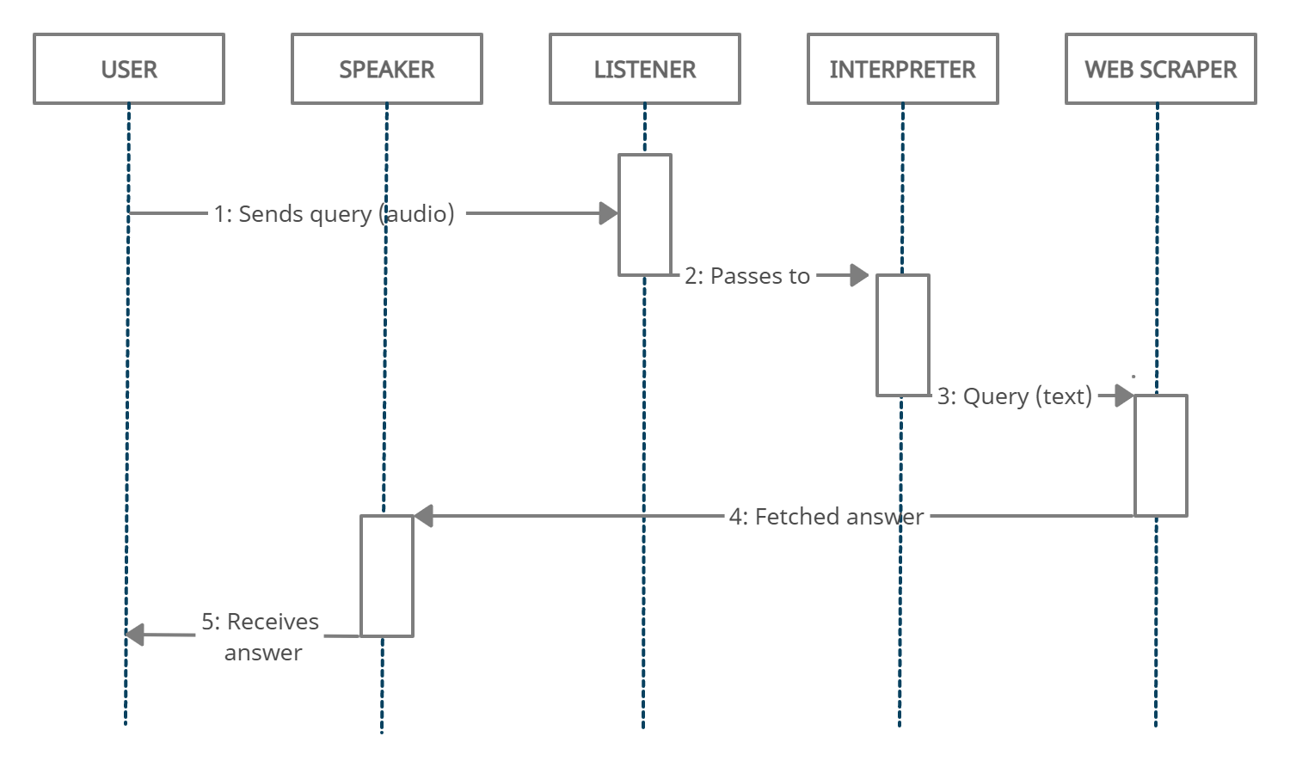
SEQUENCE DIAGRAM
1. Sequence Diagram for Query-Response
The above sequence diagram shows how an answer asked by the user is being fetched from the internet. The audio query is interpreted and sent to Web scraper. The web scraper searches and finds the answer. It is then sent back to the speaker, where it speaks the answer to the user.

Slide 41
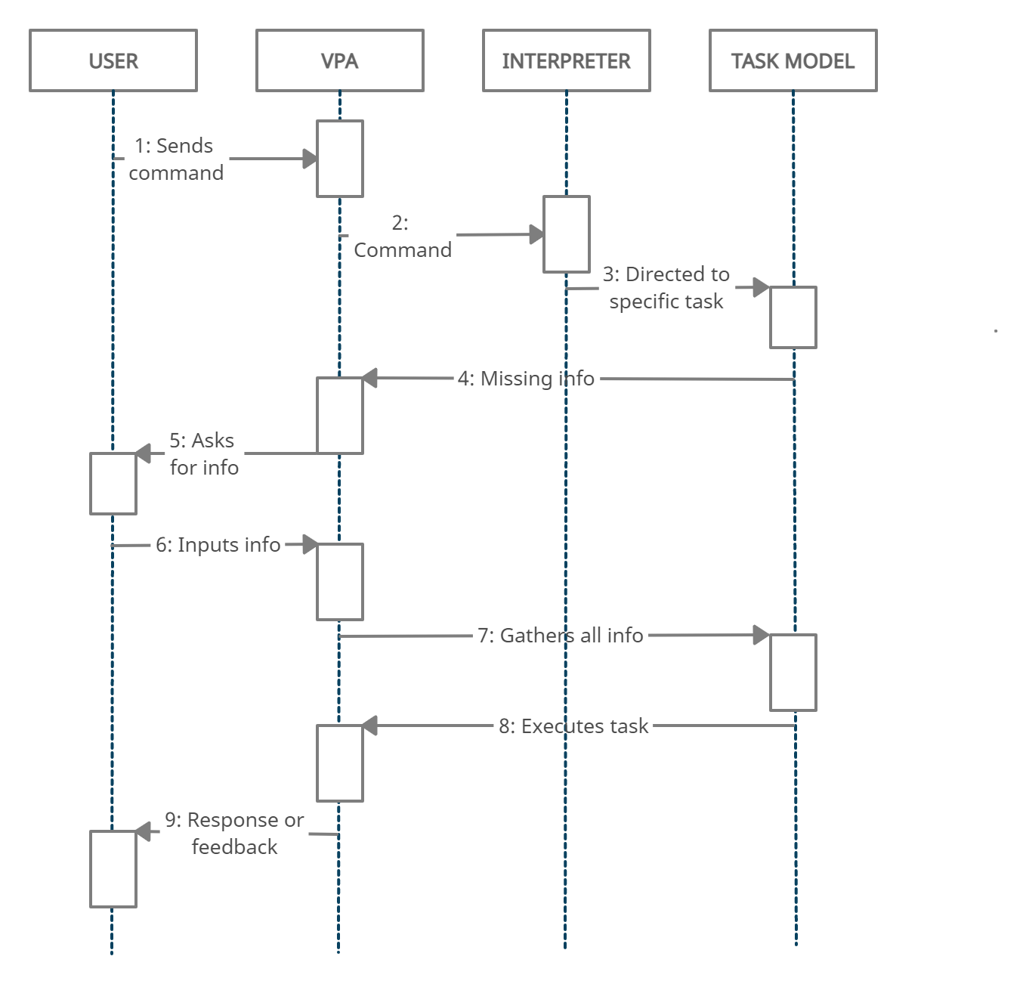
2. Sequence Diagram for task execution
The user sends commands to the virtual assistant in audio form. The command is passed to the interpreter. It identifies what the user has asked and directs it to the task executor. If the task is missing some info, the virtual assistant asks the user back about it. The received information is sent back to task and it is accomplished. After execution feedback is sent back to the user.

Slide 42
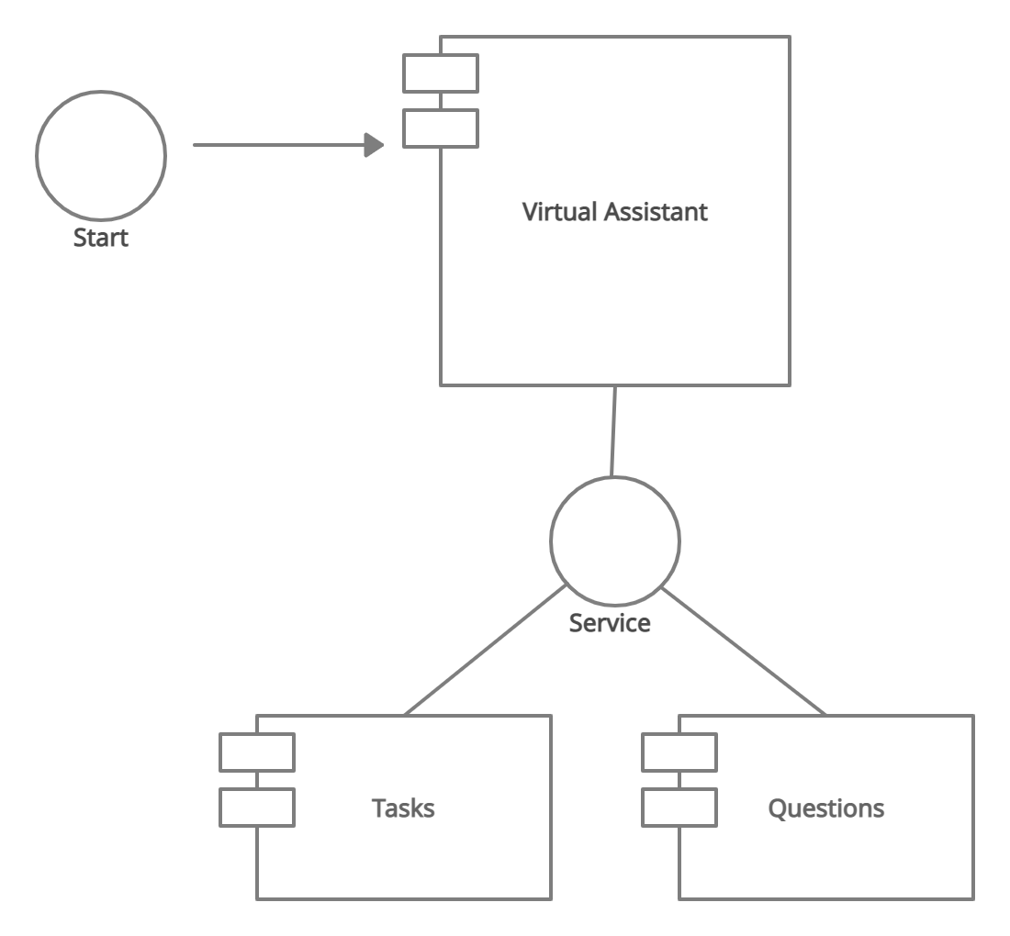
COMPONENT DIAGRAM
The main component here is the Virtual Assistant. It provides two main services, executing tasks or answering your questions.

Slide 43


Slide 44
The proposed system will have the following functionality:
(a) The assistant will be started by the user either manually or by voice activation (the voice activation command can be set by the user, like, hey Petra) and it will listen for the command or query from the user.
(b) According to the user’s question, the assistant will search for the answer and provide the best solution possible.
(c) If the assistant is unable to listen, it will again ask the user for some input. This time of asking again can be modified by the user. According to the user's preferences, the assistant can have a male or female voice.
(d) If the assistant is unable to extract information from the user's input, it will ask the user to repeat the process until the desired number of times has been reached.
(e) Finally, if the assistant doesn’t get any input, it will shut itself down. Or if the user is done with it, they can close the assistant just by saying any stop word of their choice (quit, goodbye, exit).

Slide 45


Slide 46
In this project, “Virtual Personal Assistant Using RPA, AI, and Python”, we designed and implemented digital assistance. The project is developed with open-source software components that are supported by the PyCharm community and can quickly accept any modifications. Because this project is modular, it is more adaptable and easier to add new features without disrupting existing system functionality. It not only responds to human instructions but also delivers replies depending on the inquiry or words said by the user, such as opening tasks and operations. It greets the user in a way that makes them feel more at ease and allows them to communicate freely with the voice assistant. The application should also reduce any extra manual labor that is required in the user's day-to-day tasks. The whole system is based on verbal input.
This virtual assistant can improve efficiency and offer support to both employees and customers of the organization. It allows them to offer more services by taking over more of the routine tasks. Hence, employees can spend more time on other tasks. It not only allows them to offer more and better services, but it also allows the organization to save money. This virtual assistant can increase the safety factor in automobile engineering as it can eliminate the physical interaction of the driver with the machine. They can easily communicate with the VPA through their voice, which can handle almost any query or command.

Slide 47

SCOPE

Slide 48
Virtual assistants are becoming a popular and useful technology, with a variety of advantages, contributing to the automation of tasks and providing support in time-management, accessing information, communication facilitation, etc. The technology is still in its early stages. The Virtual Assistant presented has few new functionalities compared to other assistants, but an additional and forward-looking feature may be embedded as a future work of this project. This assistant's future upgrades will combine IoT to operate nearby objects, similar to how Amazon's Alexa works. We will also try to get a version of our assistant which works on the Linux systems also, as there doesn’t exist any virtual assistant for these operating systems. It has been predicted that by 2025, 50% of knowledge workers will use a virtual assistant on a daily basis. And by 2023, 25% of employee interactions will be voice-based communications. We can also add some interesting and new functionalities such as graphic designing and blog writing which will help the users even more. We would also like to overcome a couple of hurdles in the future. First, the security of the voice transmissions needs to be addressed, so that businesses will feel comfortable accessing confidential data through voice command. Second, we need to increase the comfort level of these assistants even more, so they can be looked at as useful tools and not a time passing gimmick.
This is only the beginning; as AI and machine learning advance, our virtual assistant will get smarter and provide new possibilities.

